Slide 1
Melbourne Institute of Technology MN521 Network Automation
Telstra International Automation: A Case Study
MN521 Network Automation – Project Based Learning
Erdenebayar Dovchindorj MIT251002
9 May 2025
MIT251002 Erdenebayar Dovchindorj

Slide 2
Melbourne Institute of Technology MN521 Network Automation
Introduction & Structure
Content:
  Network Automation: key driver in modern telecoms
  Telstra: Early automation adopter – now going global
  Focus: Telstra International’s automation journey and Cisco partnership
  Structure:
    Company overview
    Problems leading to automation
    Automation strategy & goals
    Tools & technologies used
    Key use cases & benefits
    Lessons, pros, cons, and recommendations
MIT251002 Erdenebayar Dovchindorj

Slide 3
Melbourne Institute of Technology MN521 Network Automation
Telstra International – Network Overview
Content:
  Largest Australian telecom provider; global footprint in 20 countries
  Services: Wholesale, subsea, IP, Ethernet, voice, UC, etc.
  Over 400,000 km of cables, 3,500 employees
MIT251002 Erdenebayar Dovchindorj

Slide 4
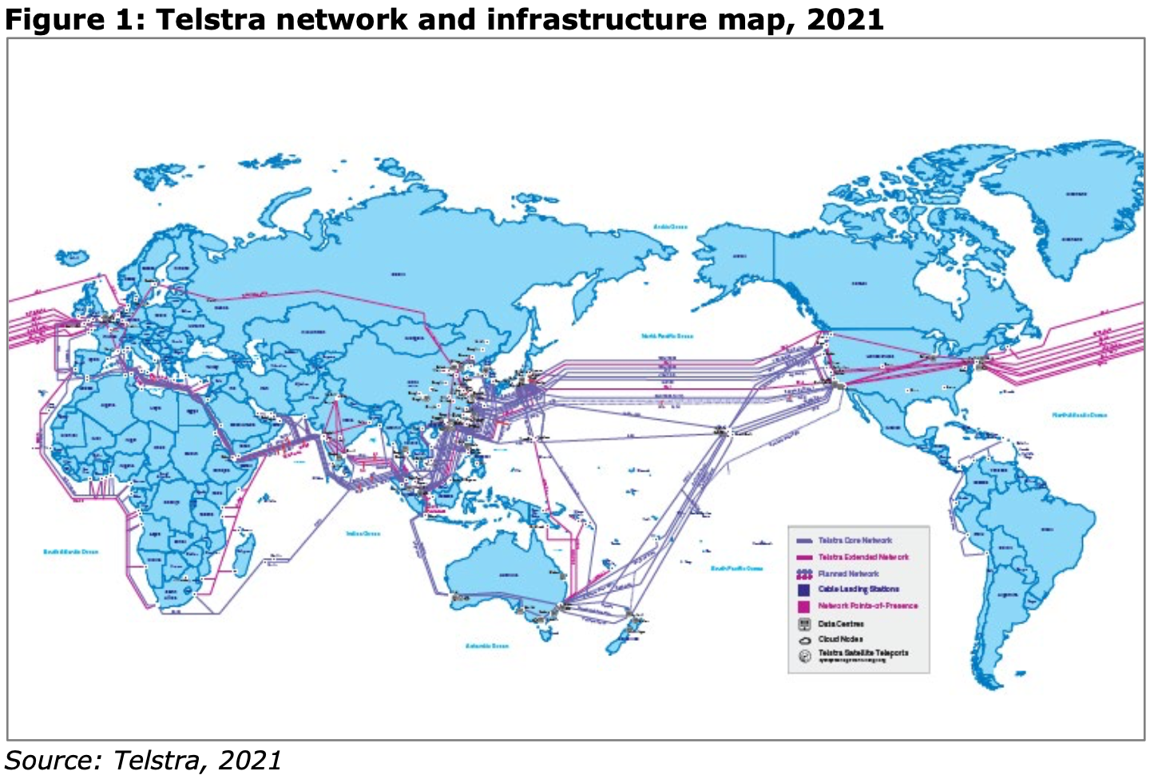
Melbourne Institute of Technology MN521 Network Automation
MIT251002 Erdenebayar Dovchindorj

Slide 5
Melbourne Institute of Technology MN521 Network Automation
Why and How – The Push for Automation
Content:
  Problems faced:
    High-profile outages due to manual errors
    Too many manual touchpoints, error compounding
    Small ops teams managing huge, complex networks
  Automation goals:
    Greater network resilience and reliability
    Improved customer experience (faster provisioning, troubleshooting)
    Standardized processes/frameworks for all teams
    Operational simplification to meet cloud-driven demands
MIT251002 Erdenebayar Dovchindorj

Slide 6
Melbourne Institute of Technology MN521 Network Automation
Technologies & Configuration Tools
Content:
  Cisco Network Services Orchestrator (NSO):
    Automates provisioning, management across multi-vendor networks
    Uses model-driven intent-based templates
  Itential Automation Platform (IAP):
    Integrates IT, inventory, analytics for end-to-end workflows
    Enables cross-domain, multi-vendor automation
  NSO + IAP manages various platforms: IP, Voice, Transport
MIT251002 Erdenebayar Dovchindorj

Slide 7
Melbourne Institute of Technology MN521 Network Automation
Automates Use Cases & Network Components
Content:
  Automated device configs: routers, switches (e.g., OS upgrades, onboarding
  Uses Cases in production:
    IP network link lifecycle (routers, switches)
    Day 1 templates for new devices
    OS upgrades (Cisco, Juniper devices)
    Voice SBC activation (Microsoft Teams integration)
    Automated NNI (Network-to-Network Interface) provisioning
  Benefits: Standard configs, fewer errors, faster rollouts, scalable ops
MIT251002 Erdenebayar Dovchindorj

Slide 8
Melbourne Institute of Technology MN521 Network Automation
Advantages, Challenges, and Solutions
Content:
  Advantages:
    Fewer manual errors; higher uptime and SLA
    Faster customer service activation
    Consistent, scalable network ops
  Challenges:
    Cultural change/ups-killing; staff retraining
    Complexity of multi-vendor, multi-domain integration
    Measuring and proving ROI
  Solutions/Lessons:
    Structured roadmap; reuse learnings from domestic network
    Partner with vendors for expertise
MIT251002 Erdenebayar Dovchindorj

Slide 9
Melbourne Institute of Technology MN521 Network Automation
Recommendations & Possible Improvements
Content:
  Further unify control across IP and optical (ongoing goal)
  Better training and transition support for staff
  Adopt more open-source/network automation tools where possible (Ansible, Python, etc.)
  Expand automation to IT and customer-facing services
  Recommendation: Continuous measurement of outcome (uptime, speed, staff hours saved)
MIT251002 Erdenebayar Dovchindorj

Slide 10
Melbourne Institute of Technology MN521 Network Automation
Conclusion
Content:
  Telstra International makes significant progress in automation
  Major benefits: resilience, customer satisfaction, future-readiness
  Still early in deployment – future: broader use cases, unified frameworks, measurable business impact
MIT251002 Erdenebayar Dovchindorj

Slide 11
Melbourne Institute of Technology MN521 Network Automation
References (IEEE Style)
Content:
  [1] Sterling Perrin, “Telstra Internation Automation: A Case Study”, Heavy Reading, July 2021.
  [2] Cisco, “Cisco Network Services Orchestrator”, https://www.cisco.com/
  [3] Itential, “Itential Automation Platform”, https://www.itential.com/
MIT251002 Erdenebayar Dovchindorj

